Slide 1
Chapter 3
1

Slide 2
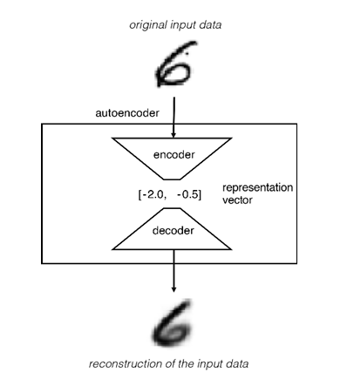
Autoencoder
An encoder network that compresses high-dimensional input data into a lower dimensional representation vector
A decoder network that decompresses a given representation vector back to the original domain

Slide 3
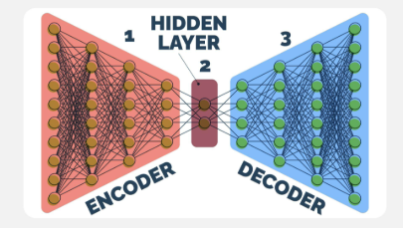

Slide 4
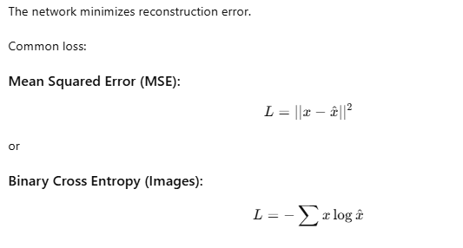
Training Objective (Loss Function)

Slide 5
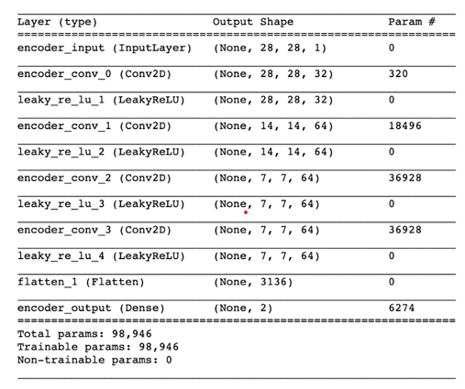
Encoder

Slide 6
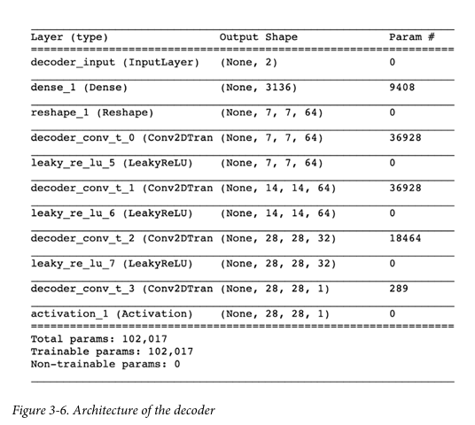
Decoder
Note that the decoder doesn’t have to be a mirror image of the encoder. It can be any thing you want, as long as the output from the last layer of the decoder is the same size as the input to the encoder

Slide 7
Regular Autoencoder vs Variational Autoencoder (VAE)
Aspect | Regular Autoencoder (AE) | Variational Autoencoder (VAE)
Main Idea | Learns compressed representation of data | Learns probability distribution of data
Type | Deterministic Model | Probabilistic Generative Model
Latent Space | Fixed vector representation | Distribution (Mean + Variance)
Encoder Output | Single latent vector (z) | Mean and Variance
Decoder Input | Direct encoded vector | Random sample from learned distribution
Sampling | No sampling | Sampling using reparameterization trick
Loss Function | Reconstruction Loss only | Reconstruction Loss + KL Divergence
Latent Space Structure | Unstructured | Continuous smooth latent space
Generative Ability | Poor | Excellent
Data Generation | Cannot generate new realistic samples | Can generate new samples
Applications | Compression, Feature Extraction | Image Generation, Data Augmentation

Slide 8
Variational Autoencoder
What we need to do to our autoencoder to convert it into a variational autoencoder ?
Thus make it a truly generative model.
There are actually only two parts that we need to change:
Encoder
Loss function.

Slide 9
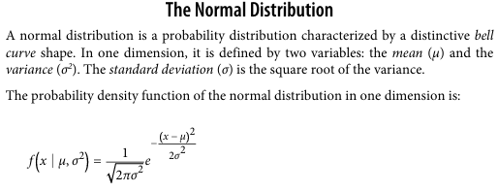

Slide 10
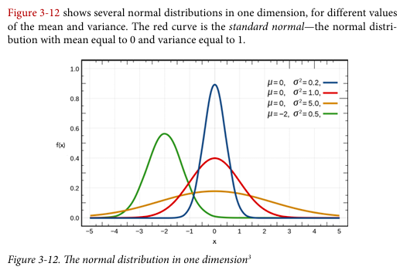

Slide 11
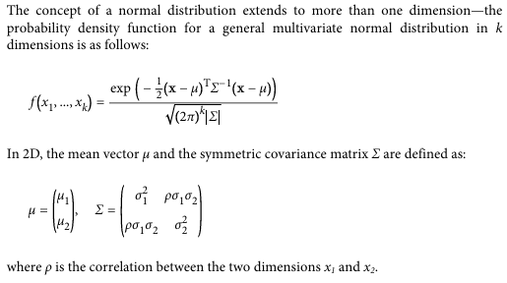

Slide 12
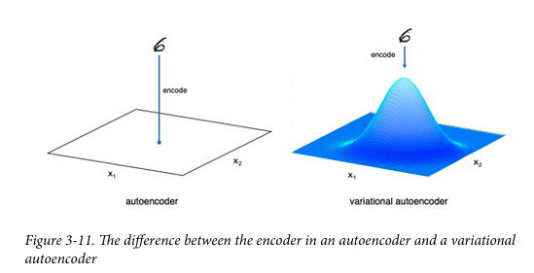
In an autoencoder, each image is mapped directly to one point in the latent space. In a variational autoencoder, each image is instead mapped to a multivariate normal distribution around a point in the latent space, as shown in Figure

Slide 13
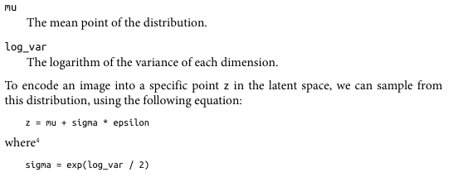
epsilon is a point sampled from the standard normal distribution.

Slide 14
Variational autoencoders assume that there is no correlation between any of the dimensions in the latent space and therefore that the covariance matrix is diagonal.
This means the encoder only needs to map each input to a mean vector and a var iance vector and does not need to worry about covariance between dimensions.

Slide 15
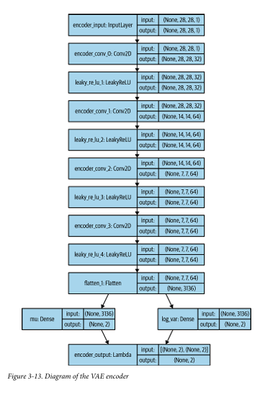

Slide 16
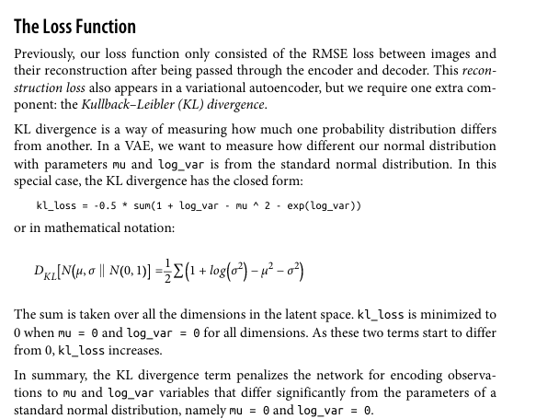

Slide 17
Diffusion Models
Diffusion models are a type of generative AI that create new data like images, audio or even video by starting with random noise and gradually turning it into something meaningful.
They work by simulating a diffusion process where data is slowly corrupted by noise during training and then learning to reverse this process step by step.
By doing so the model learns how to generate high quality samples from scratch.

Slide 18
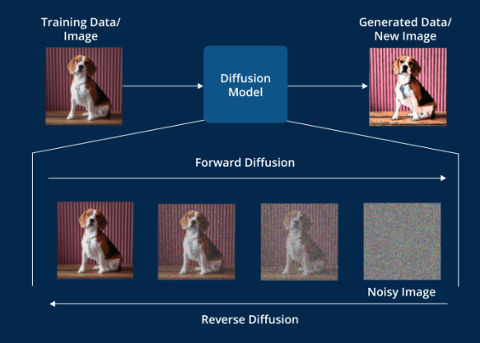

Slide 19
Diffusion models are generative models that learn to reverse a diffusion process to generate data. The diffusion process involves gradually adding noise to data until it becomes pure noise.
Through this process a simple distribution is transformed into a complex data distribution in a series of small incremental steps.
Essentially these models operate as a reverse diffusion phenomenon where noise is introduced to the data in a forward manner and removed in a reverse manner to generate new data samples.
By learning to reverse this process diffusion models start from noise and gradually denoise it to produce data that closely resembles the training examples.

Slide 20
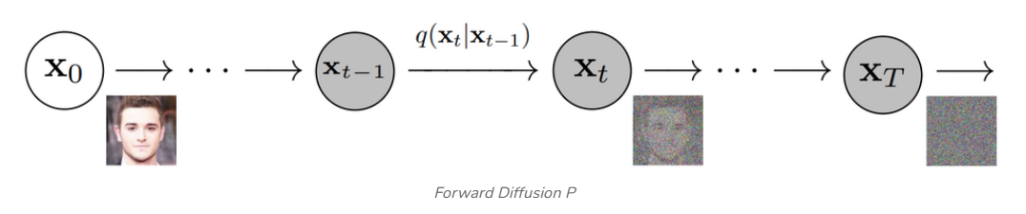
A Markov chain is a way to describe a system that moves between different situations called "states", where the chain assumes the probability of being in a particular state at the next step depends solely on the current state.
Forward Diffusion Process
In this process noise is incrementally added to the data over a series of steps. This is akin to a Markov chain where each step slightly degrades the data by adding Gaussian noise.

Slide 21

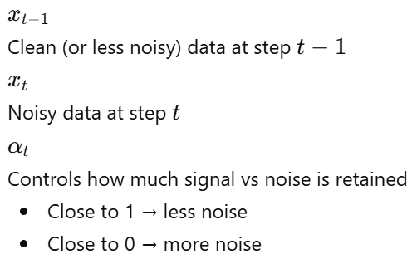
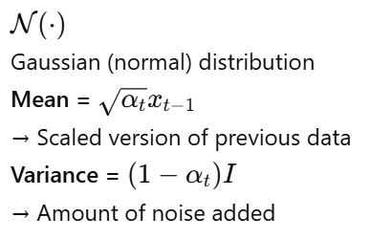
Mathematical Representation

Slide 22
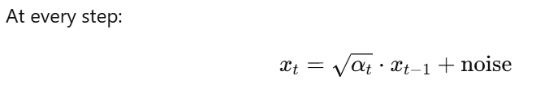


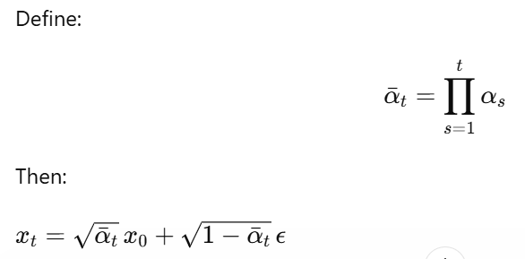
add Gaussian noise gradually
Multi-step (Closed form)

Slide 23
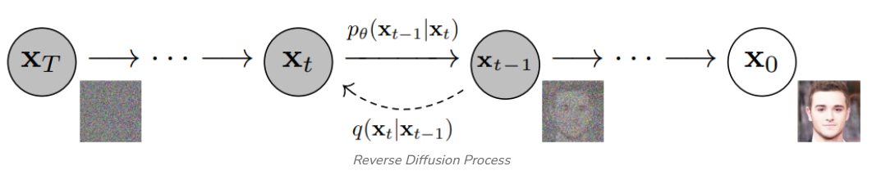
2. Reverse Diffusion Process
The reverse process aims to reconstruct the original data by denoising the noisy data in a series of steps reversing the forward diffusion.

Slide 24



Mathematical Expression
Process | Equation | Meaning
Forward |  | Add noise
Reverse |  | Remove noise

Slide 25
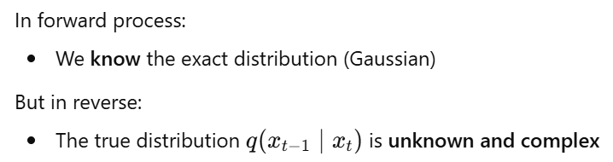
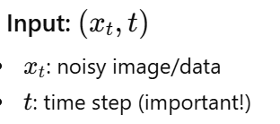
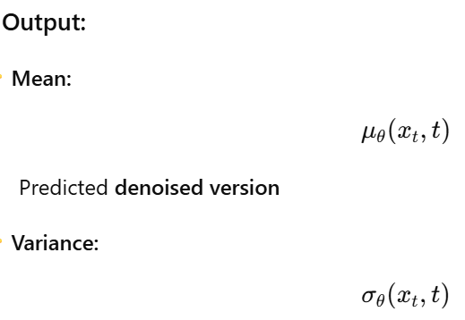
Why do we need a neural network?

Slide 26
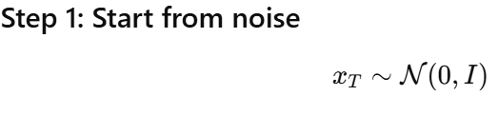
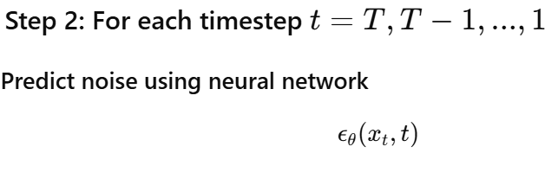

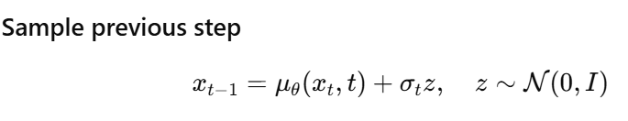

Slide 27

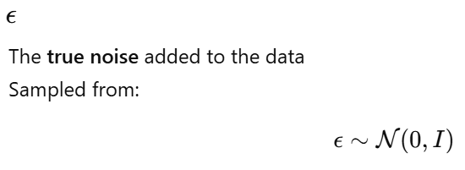
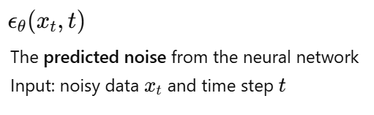
Training Loss

Slide 28
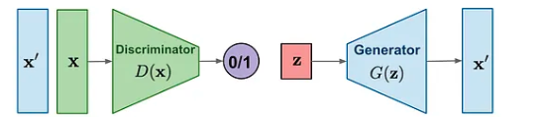
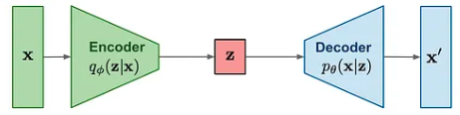
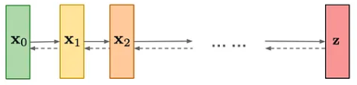
Flow Based Model
GAN
VAE
Diffusion Model

Slide 29
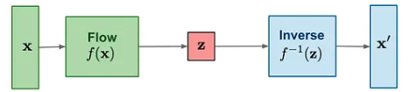
A flow-based generative model is a type of generative model that learns a invertible mapping between a simple probability distribution (like Gaussian) and complex data (like images).
Instead of generating data directly, it transforms a simple distribution into data using invertible functions.

Slide 30
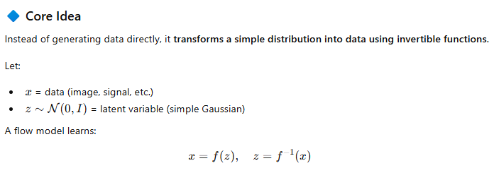
Important Concept:
Invertible Transformation
Jacobian Matrix

